Slide 1
Solar irradiation prediction

Slide 2
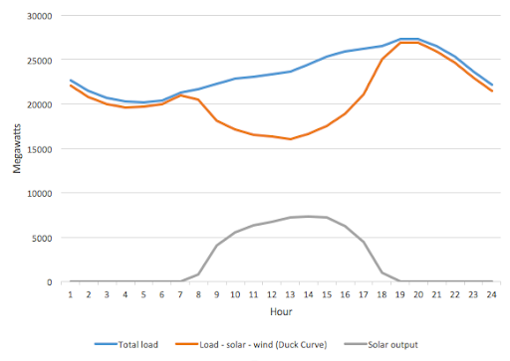
Background
Prediction of solar irradiance is essential for minimizing energy costs and providing high power quality in electrical power grids
For residential and small commercial users deploying on-site photovoltaic generations, the historical irradiance data can not be obtained directly because of expensive solar irradiance meters.
According to the proposed regulations, wind and solar power generators will not have to pay penalties for up to 10% deviation in scheduling power. For deviation beyond 10%, they will have to pay charges at 10% of the normal rate.
There is a need to predict solar power generation as passing clouds would cause power plants to quickly ramp up / ramp down to match the electrical demand.
Notes:
Thanks to increasingly improved weather forecasting service provided by local meteorological organizations, weather forecasting data such as temperature, dew point, humidity, visibility, wind speed and descriptive weather summary, are becoming readily available through the Internet, while the irradiance forecasting data are often unavailable.

Slide 3
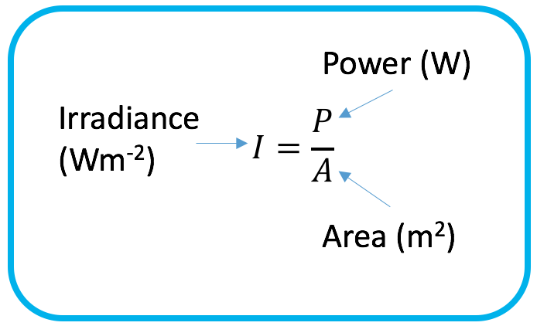
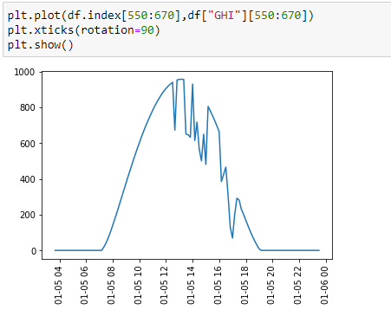
What is irradiance?
Amount of solar power per m^2
Typical curve in SG

Slide 4
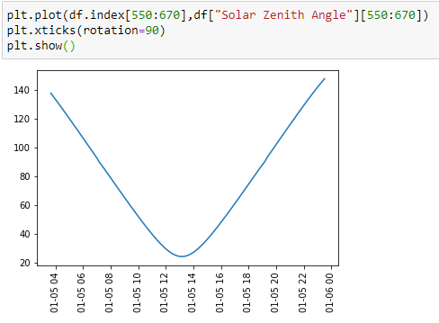
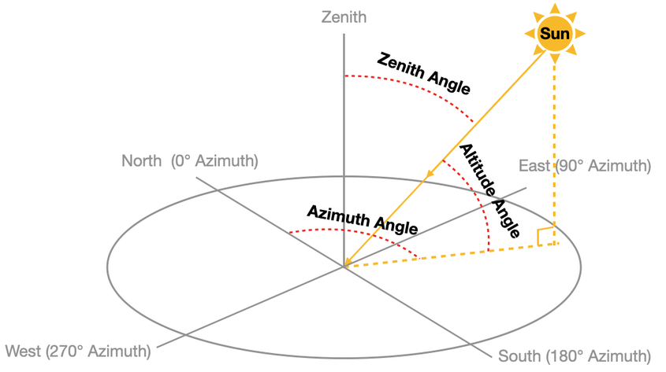
How to predict?
Intuitively, the amount of sunlight is determined by the cloud cover in SG.
Sun angle / time of the day.
Cloud is hard to predict.
Temp & RH indicative

Slide 5
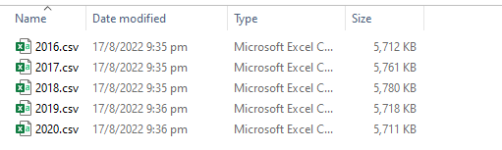
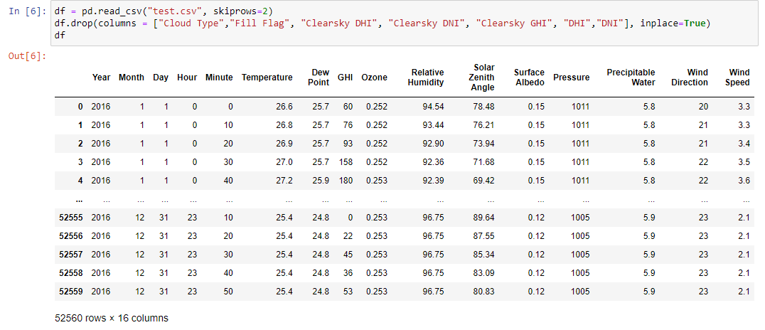
Lots of data from The National Solar Radiation Database (NSRDB)
5 years of 10mins interval data
GHI = global horizontal irradiance

Slide 6
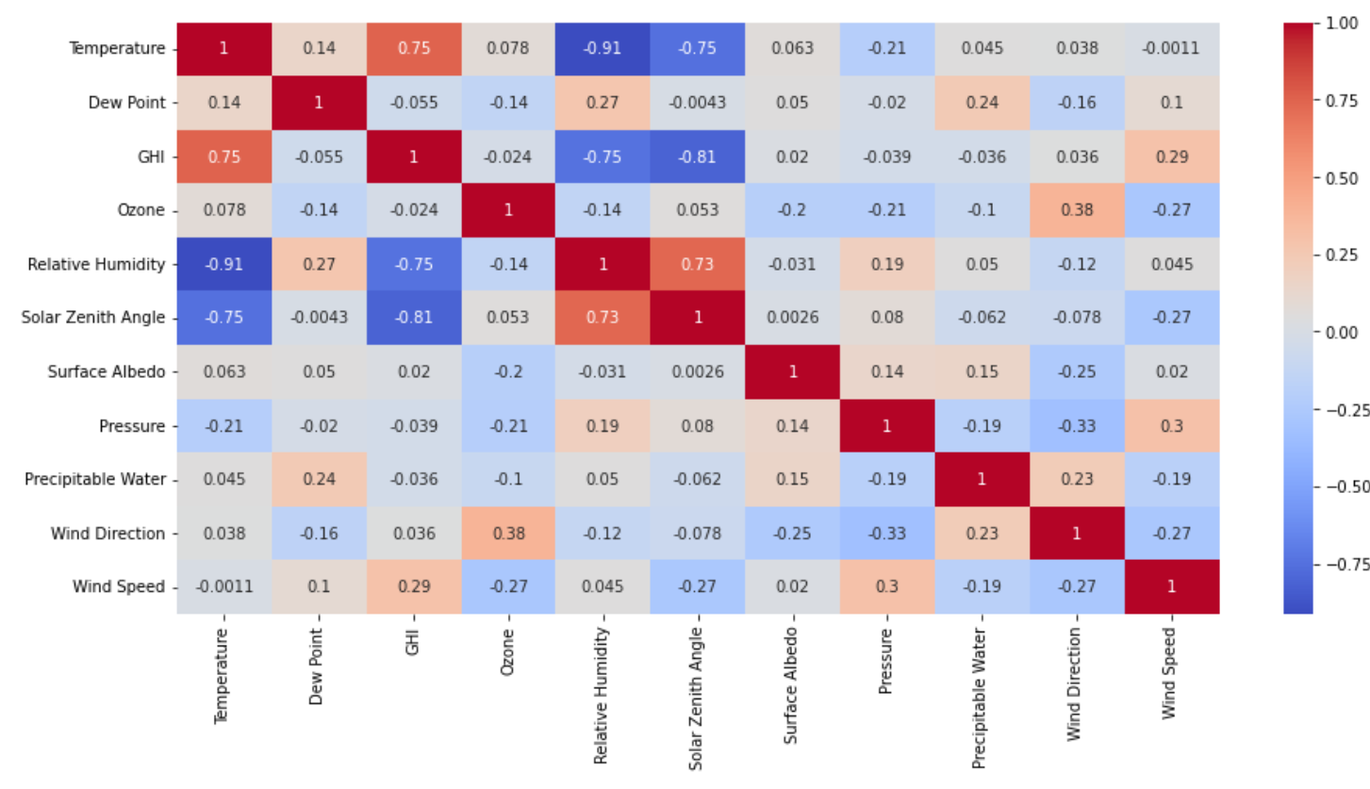
Heatmap

Slide 7
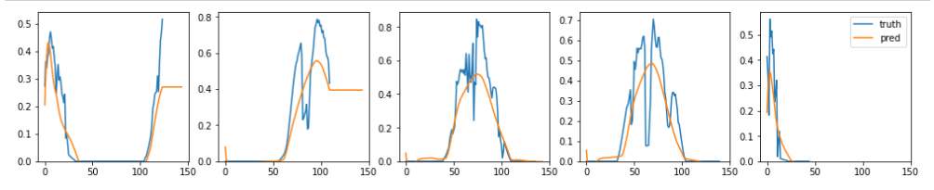
Models
Univariate ARIMA
Multivariate ARIMA
Deep learning – RNN (LSTM)

Slide 8
What is the end product?
5 days forecast (3 hourly interval)
{
"dt": 1661104800,
"main": {
"temp": 297.25,
"feels_like": 298.14,
"temp_min": 297.25,
"temp_max": 297.25,
"pressure": 1009,
"sea_level": 1009,
"grnd_level": 1006,
"humidity": 93,
"temp_kf": 0
},
"weather": [
{
"id": 501,
"main": "Rain",
"description": "moderate rain",
"icon": "10n"
}
],
"clouds": {
"all": 100
},
"wind": {
"speed": 3.37,
"deg": 219,
"gust": 5.17
},
"visibility": 8485,
"pop": 1,
"rain": {
"3h": 7.41
},
"sys": {
"pod": "n"
},
"dt_txt": "2022-08-21 18:00:00"
},
Real weather API json
{
"coord": {
"lon": 103.8233,
"lat": 1.3717
},
"weather": [
{
"id": 803,
"main": "Clouds",
"description": "broken clouds",
"icon": "04n"
}
],
"base": "stations",
"main": {
"temp": 28.88,
"feels_like": 33.21,
"temp_min": 27.83,
"temp_max": 28.97,
"pressure": 1010,
"humidity": 74
},
"visibility": 10000,
"wind": {
"speed": 4.12,
"deg": 120
},
"clouds": {
"all": 75
},
An app that regularly calls current weather API or even weather forecasts and predict the irradiance.
Unfortunately, NSRDB do not provide real time weather data.
Closest I could find was from openweather api.
Data provided has cloud type, which could be interpolated.
Year | Month | Day | Hour | Minute | Temperature | Clearsky DHI | Clearsky DNI | Clearsky GHI | Cloud Type
2016 | 1 | 1 | 0 | 0 | 26.6 | 78 | 276 | 133 | 6
2016 | 1 | 1 | 0 | 10 | 26.8 | 89 | 336 | 170 | 6
2016 | 1 | 1 | 0 | 20 | 26.9 | 99 | 389 | 207 | 6
2016 | 1 | 1 | 0 | 30 | 27 | 108 | 435 | 245 | 6
2016 | 1 | 1 | 0 | 40 | 27.2 | 121 | 457 | 282 | 7
2016 | 1 | 1 | 0 | 50 | 27.3 | 128 | 494 | 320 | 6
2016 | 1 | 1 | 1 | 0 | 27.4 | 135 | 527 | 359 | 6
2016 | 1 | 1 | 1 | 10 | 27.6 | 141 | 557 | 397 | 6
2016 | 1 | 1 | 1 | 20 | 27.7 | 147 | 584 | 435 | 6
2016 | 1 | 1 | 1 | 30 | 27.8 | 152 | 608 | 472 | 7
2016 | 1 | 1 | 1 | 40 | 27.9 | 164 | 612 | 506 | 7
2016 | 1 | 1 | 1 | 50 | 28 | 169 | 632 | 541 | 7
Cloud Type 0 | Cloud Type 1 | Cloud Type 2 | Cloud Type 3 | Cloud Type 4 | Cloud Type 5 | Cloud Type 6 | Cloud Type 7 | Cloud Type 8 | Cloud Type 9 | Cloud Type 10 | Cloud Type 11 | Cloud Type 12
Clear | Probably Clear | Fog | Water | Super-Cooled Water | Mixed | Opaque Ice | Cirrus | Overlapping | Overshooting | Unknown | Dust | Smoke

